Slide 1

Basics of Electronics
Module
Rohit Kumar

Slide 2
Contents
Title | Page
Resistors
Capacitors
Diodes
Transistors

Slide 3
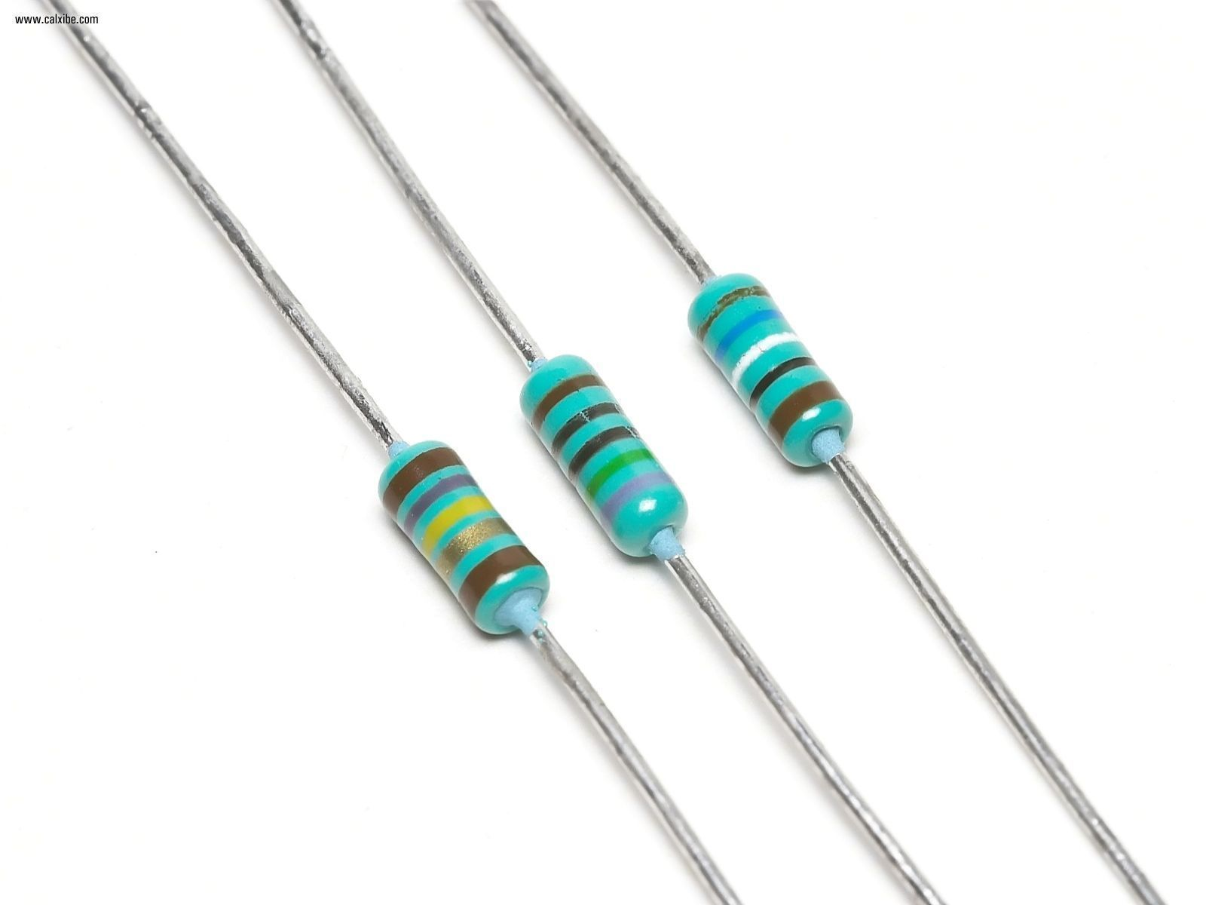
Resistors
Resistors are used to limit current or divide voltage and in some cases, generate heat
Used for driving circuit which requires low current and voltage than available
A two terminal, non polarised component
Unit of Resistance is Ohm
Notation of Resistance :
O – Ohm
K – Kilo Ohm
M – Mega Ohm

Slide 4
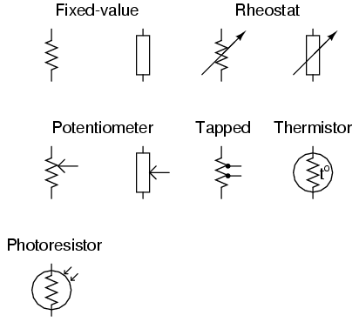
Symbol of Resistors
1
2
Fixed Value Resistor
Rheostat
Potentiometer
Light Dependent Resistor
Thermistor
3
4
5

Slide 5
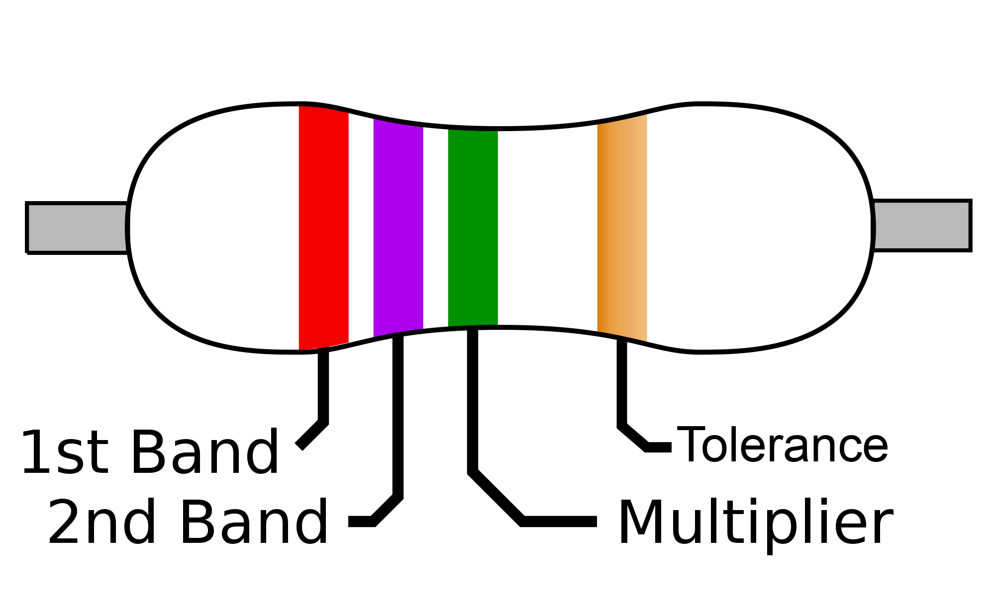
Physical Appearance

Slide 6
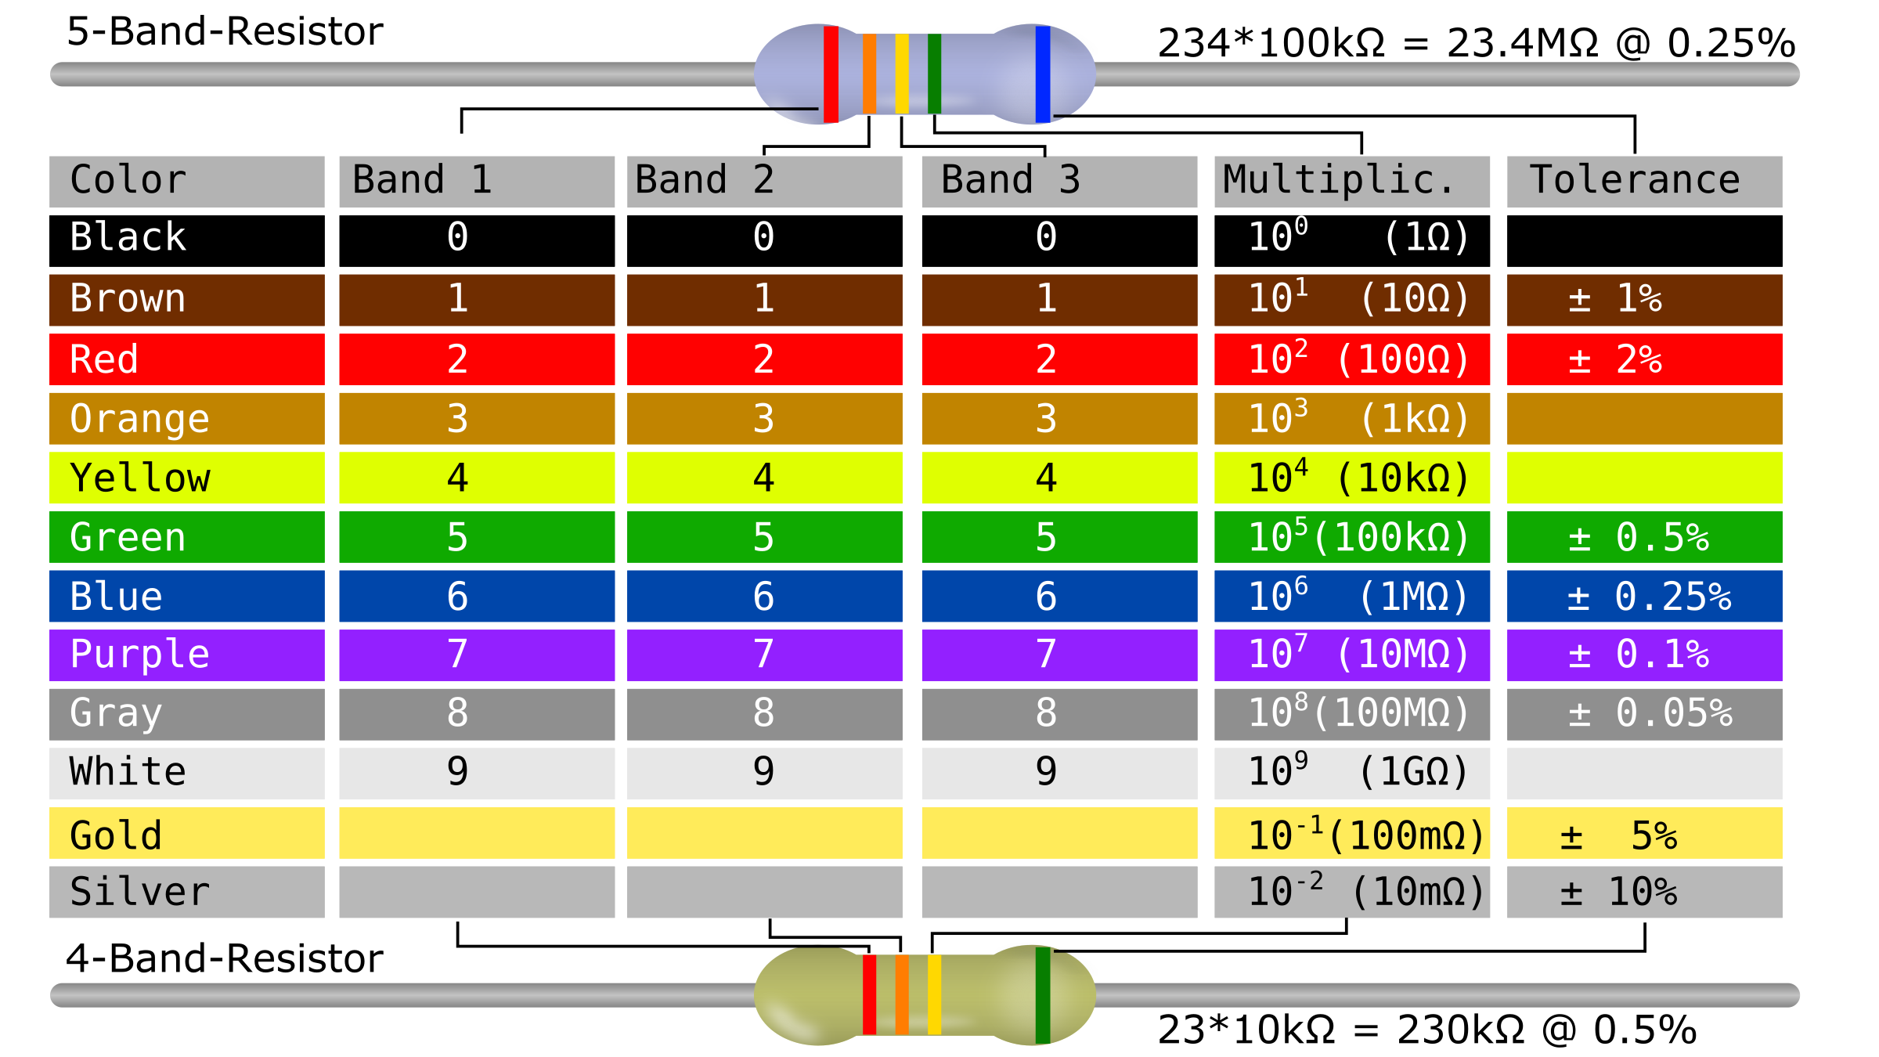
Color Code Table
R = 1st Digit x 10 + 2nd Digit) x Multiplier

Slide 7
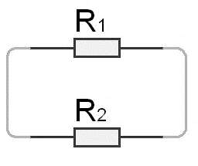
Practical Use
To reduce the current flowing in the circuit, resistances are used in parallel topology.

Slide 8
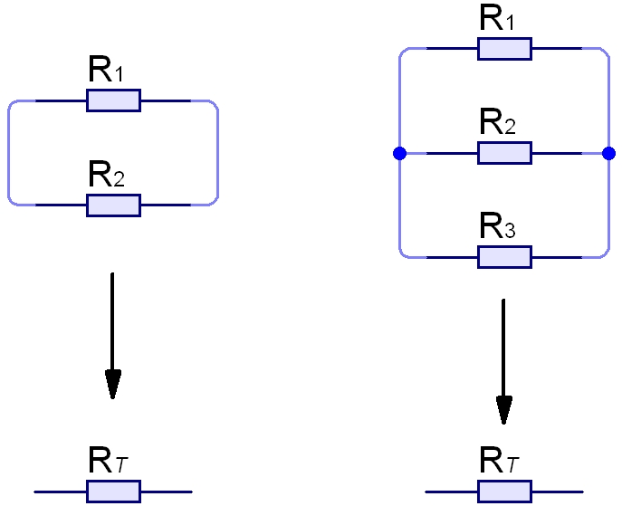
Practical Use
To reduce the voltage flowing in the circuit, resistances are used in series topology.

Slide 9
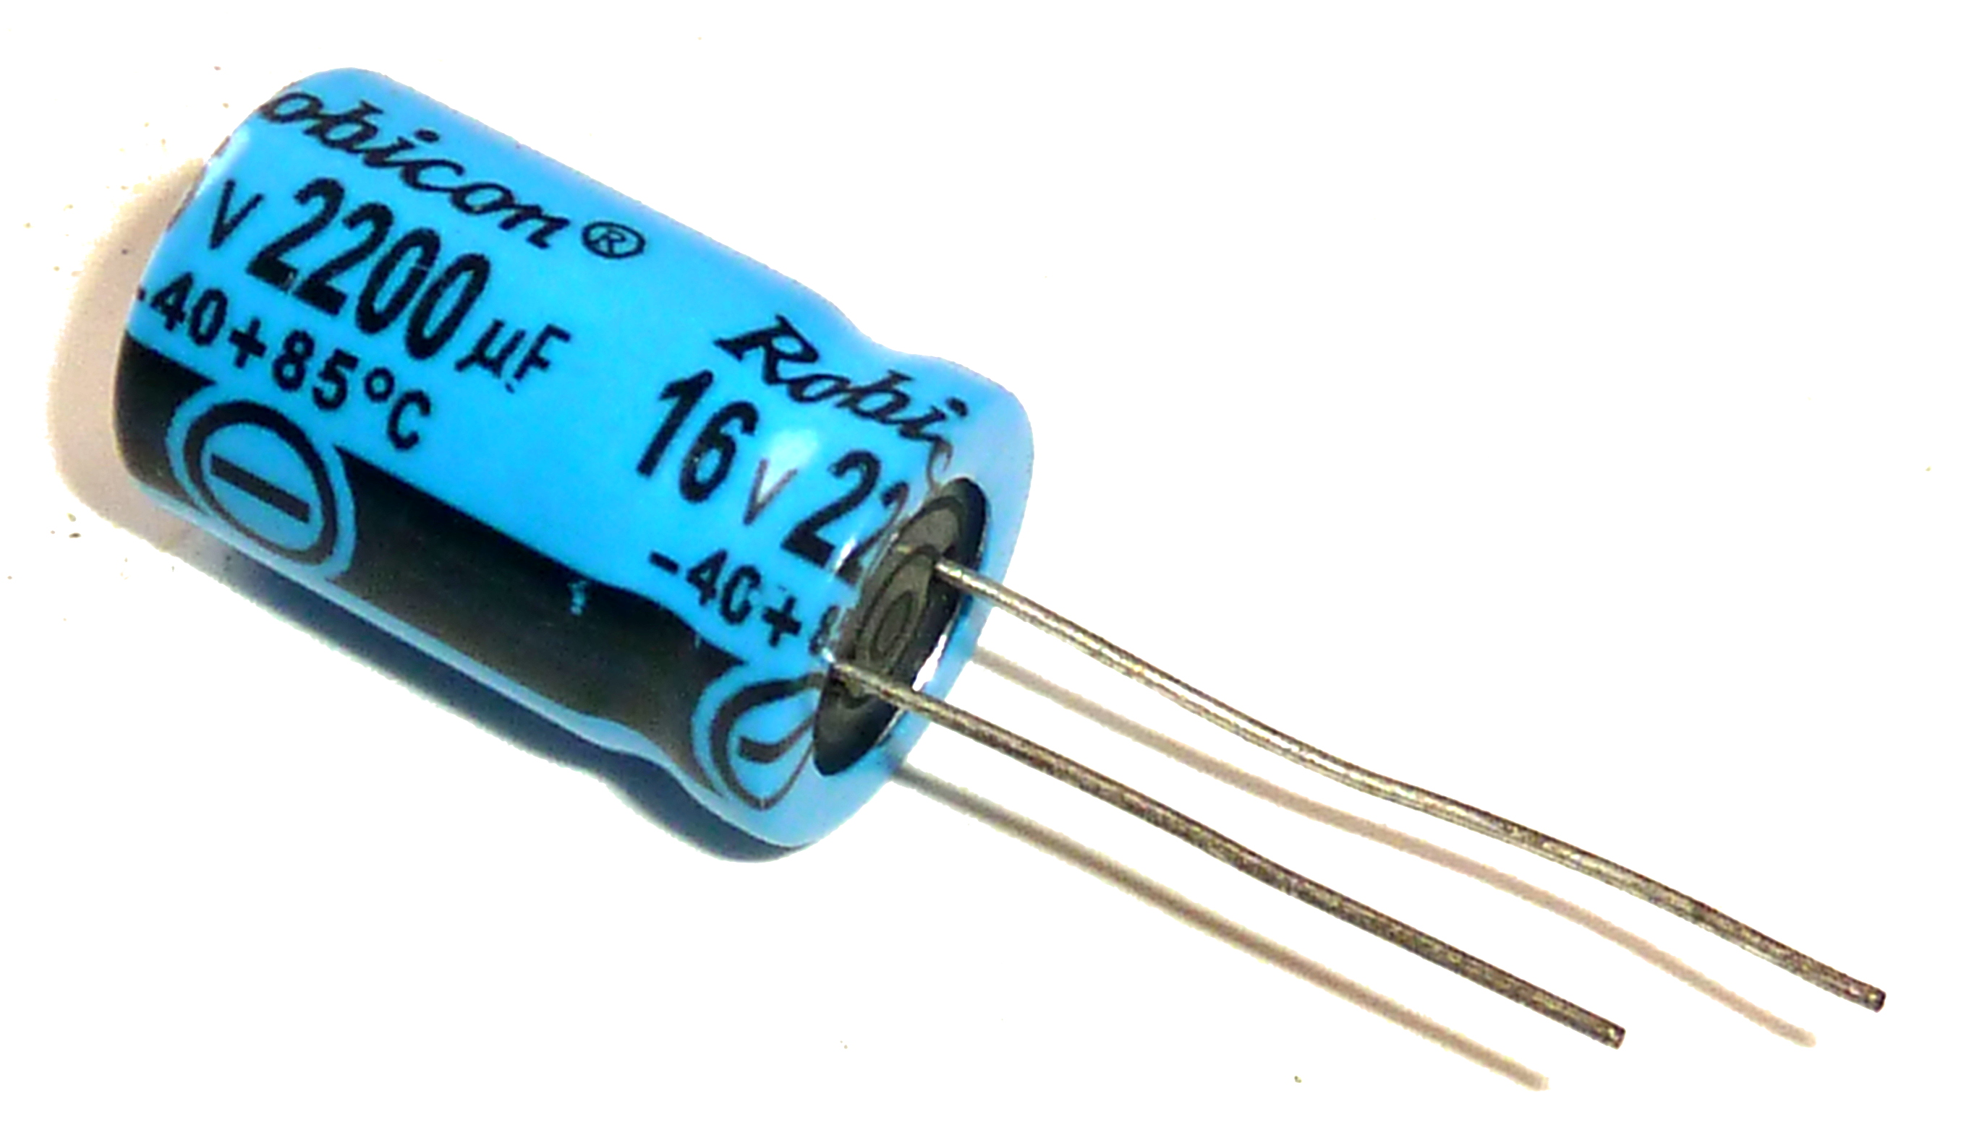
Capacitors
A two terminal electronic component which stores energy in form of charge
Capacitance is a measure of a capacitor’s ability to store charge
A large capacitance means that more charge can be stored
Capacitance is measured in Farads(F) but prefixes like uF and pF is used mostly.

Slide 10
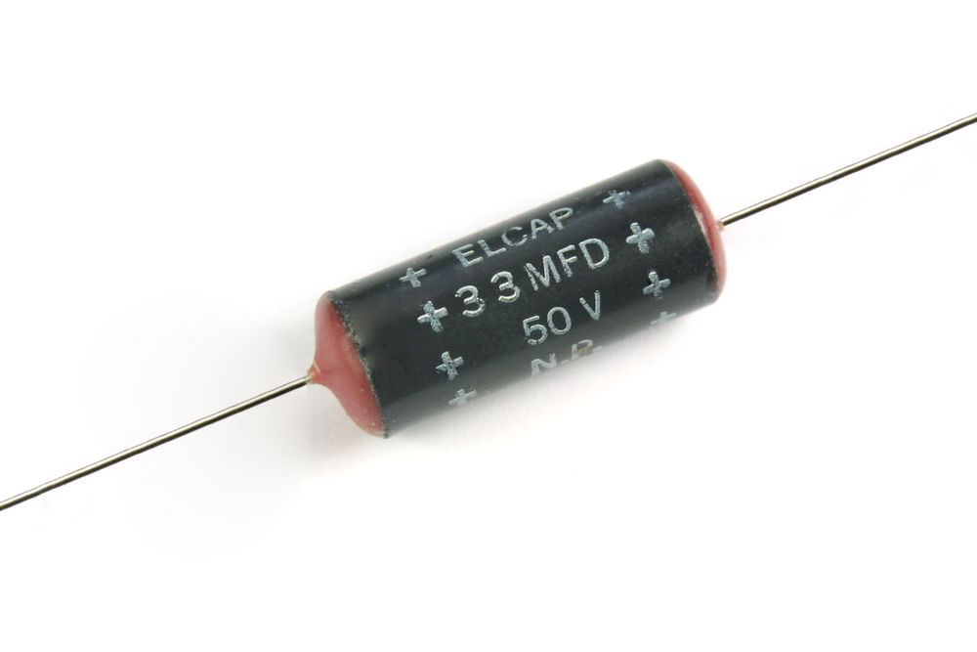
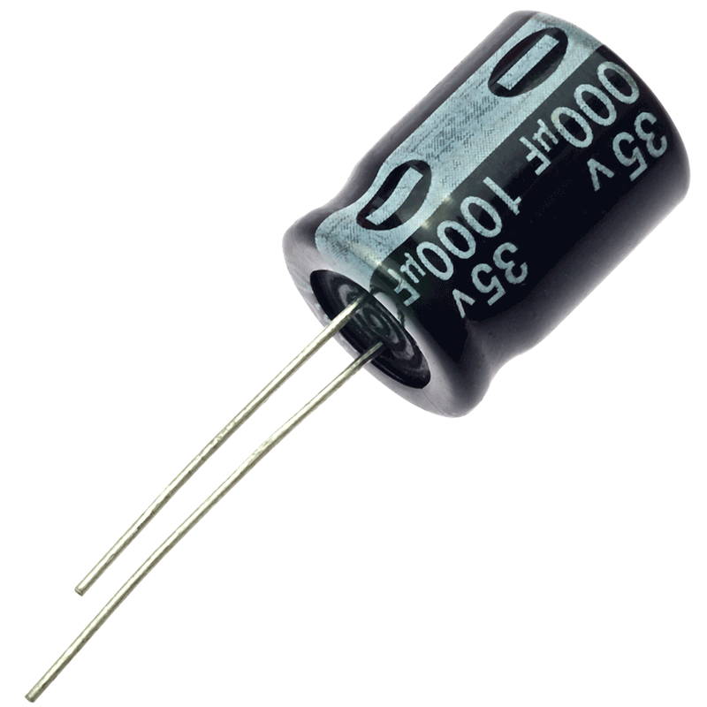
Types of capacitors
Non-Polarised
These are the ones which do not have any specific polarity for terminals
Polarised
These are the ones which do have specified positive and negative terminals
1
2

Slide 11
Practical Use
Used for making timer circuits, when used with resistance.
Used for providing instantaneous large power as in flashlight cameras
Used in clipper, clamper circuit
Used in DC filter circuits

Slide 12
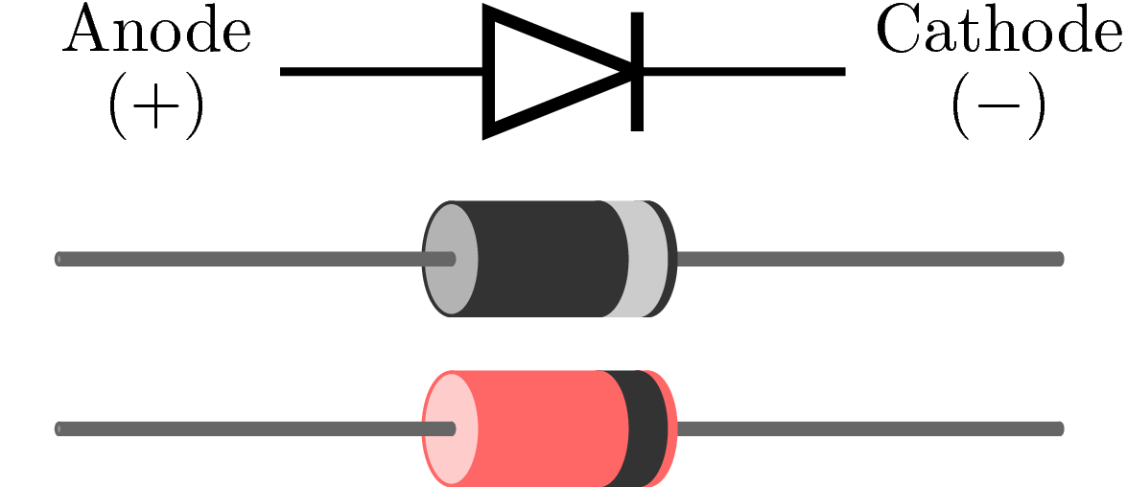
Diode
A two terminal electronic component that conducts electric current in only one direction
Terms diode means two electrodes
Diode is also known as a p-n junction device

Slide 13
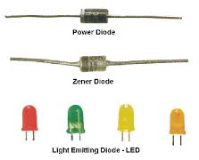
Types of Diodes
Power Diode
Zener Diode
LED (Light Emitting Diode)
And many others……

Slide 14
Practical Use
Used for making Logic gates.
Used for temperature measurement.
Used in Power conversion circuits.
Used in optical applications.

Slide 15
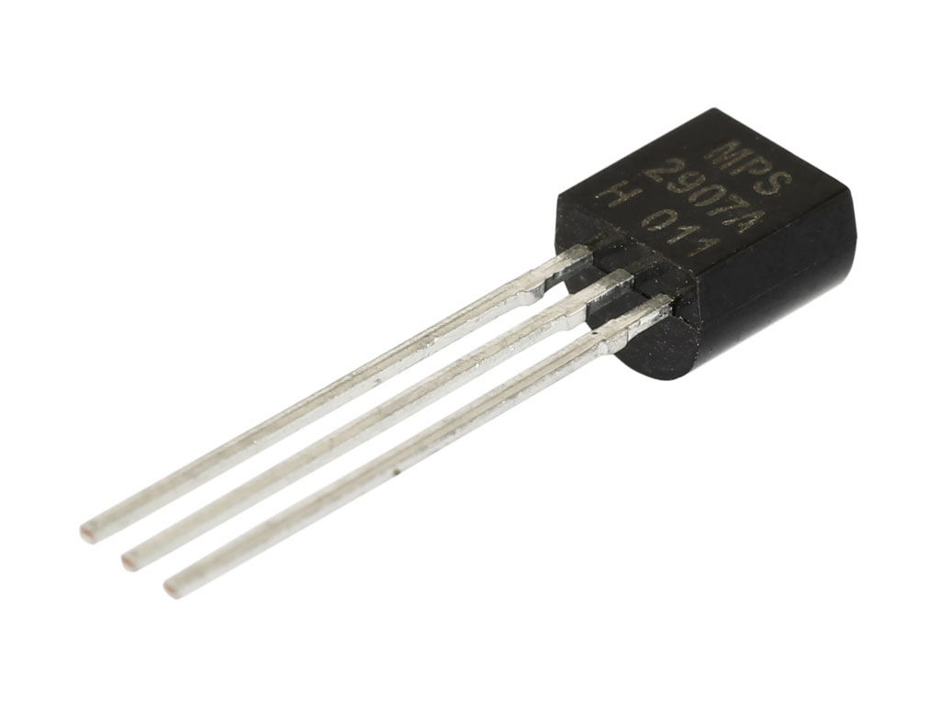
Transistor
A transistor is a semiconductor device commonly used to amplify or switch electronic signals
Transistor is a three terminal device
Three Terminals are Emitter, Base and Collector

Slide 16
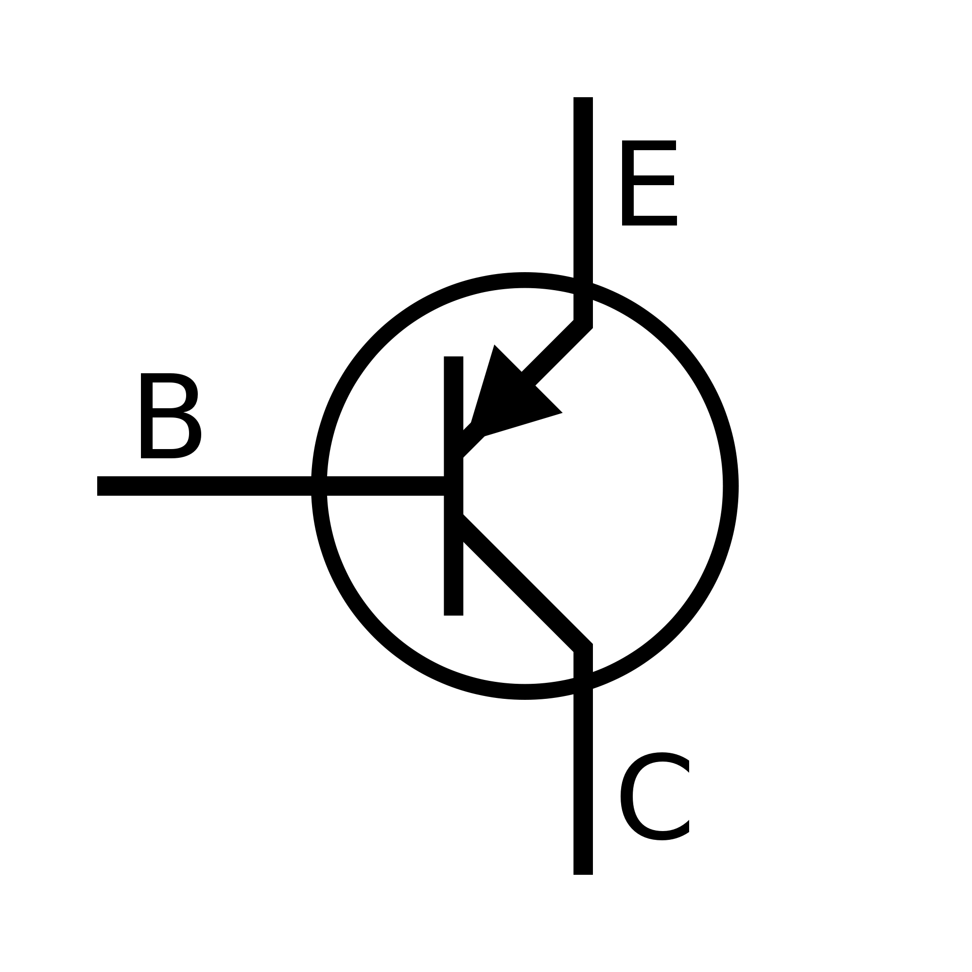
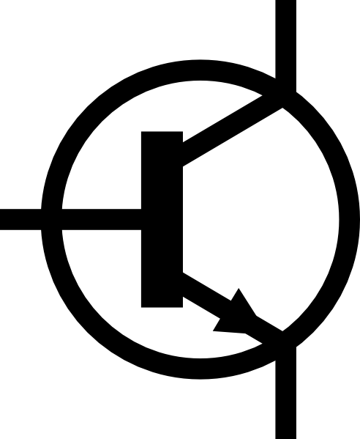
Types of Transistors
C
B
E
N-P-N transistor
Works as a straight Switch
P-N-P transistor
Works as an inverted Switch

Slide 17
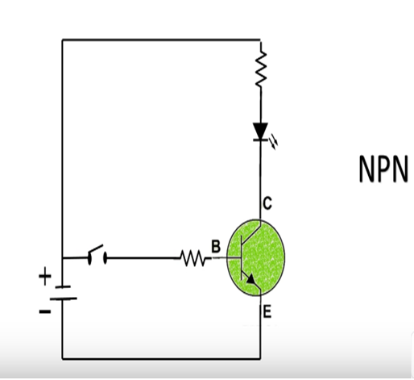
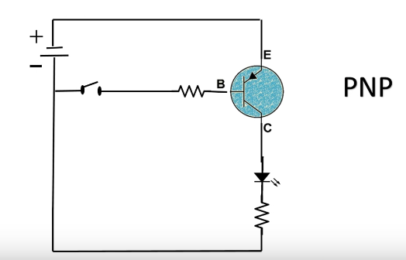
Types of Transistors

Slide 18
Practical Use
Used as Switch in electronics.
Used as amplifier in circuits for low signal.

Slide 19
Thank You !
Contact US
Nitin Sinha
nitin.sinha@goSigmaWay.com
+1 727-394-4375
+91 7838188809
Debjani Mitra
debjani.mitra@goSigmaWay.com
+1 952-583-3449
+91 9339555636
Rohit Kumar
rohit.kumar@sigmaway.us
+91 7982577830
+91 7838021754

